Slide 1

VNDM2 - Technical Sharing
Dbt – 101
Chuong.Nguyen​
October-2023

Slide 2

Agenda
Dbt introduction
Installation
Dbt structure
Dbt_project ; Var
Directories Structure : Source ; Seed; Staging ; Mart
Models
Materialization
Scd-type2 with Snapshot model
Incremental model
Data Quality (Test Vs Contract)
Dbt-expactations and Dbt-util
Dbt best practise

Slide 3
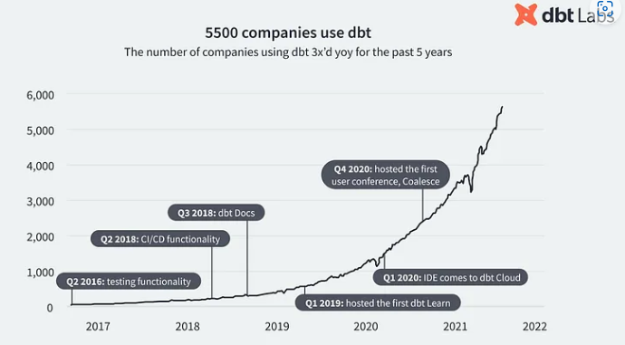
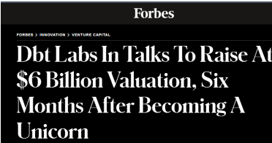
History
Started at RJMetric 2016 (by Stitch) accquired by Talend
Commercial product in 2018, the dbt Labs team (Fishtown Analytics)
Funding : February 2022, the company raised $222 million for its Series D, at a $6 billion valuation

Slide 4

What is DBT ?

Slide 5

DBT is not Dialectical Behavior Therapy :D

Slide 6
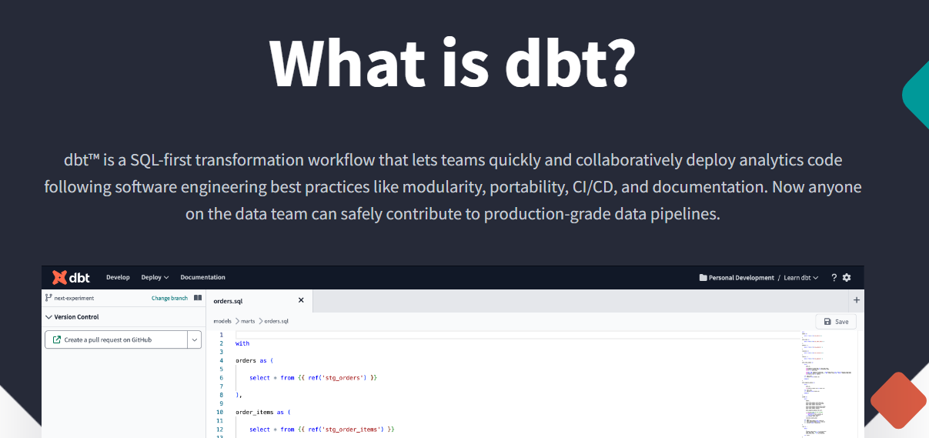
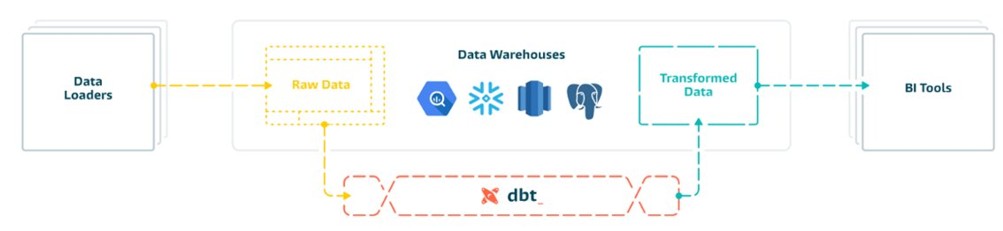
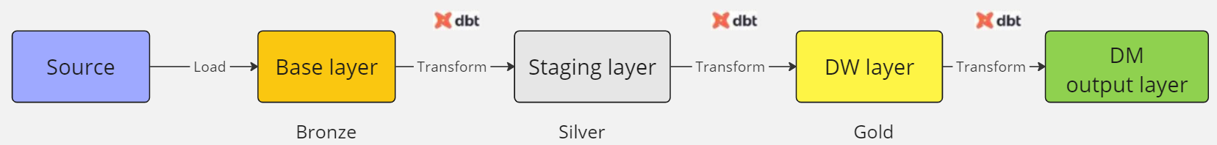
dbt = Data Build Tool
But 'T' mean Transform
What is dbt? (getdbt.com)
Notes:
Supported data platforms | dbt Developer Hub (getdbt.com)
What is dbt (data build tool) and What Can It Do for My Data Pipeline? (analytics8.com)
Dbt : là 1 framework hay là 1 workflow

Slide 7

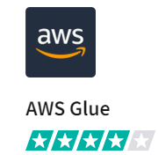
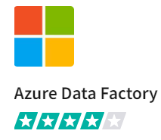

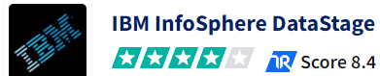

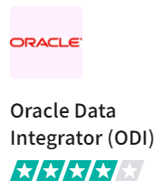

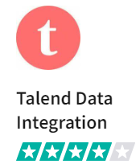
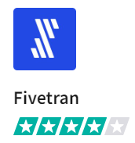

Competitors and Alternative
Notes:
List of Best dbt Alternatives & Competitors 2023 (trustradius.com)

Slide 8
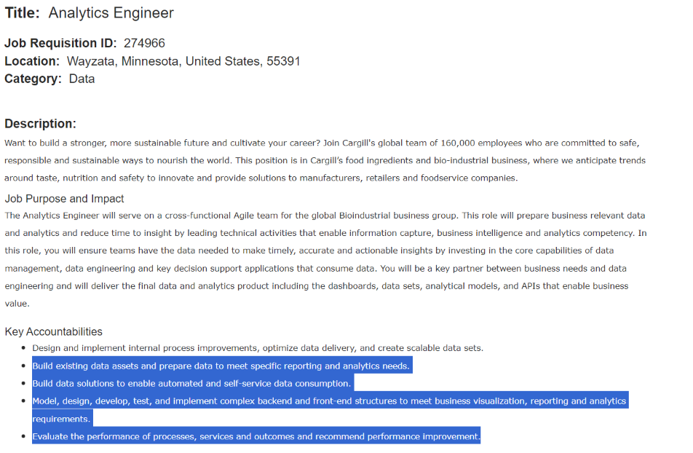
Analytics engineer
Analytics engineer duties and responsibilities - Data modeling - Data transformation - Data-associated documentation - Defining data quality rules, standards, and metrics - Data visualization - DataOps version control data unit testing CI/CD
Analytics engineer skills and toolkit knowledge - SQL skills - Experience in data programming languages : R and Python - The dbt technology knowledge - Git expertise - Data engineering and BI tools knowledge - Interpersonal and communication skills
dbt and the Analytics Engineer — what’s the hype about? | by Oliver Molander | VALIDIO | Medium
Become an Analytics Engineer in 90 Days | by Tuan Nguyen | Medium
Analytics engineer: Job description, Skills, and Responsibilities | AltexSoft
Notes:
Ana_Eng :
- nhận data thô - cleaning / masking data - transform - modeling – provide data to user

Slide 9
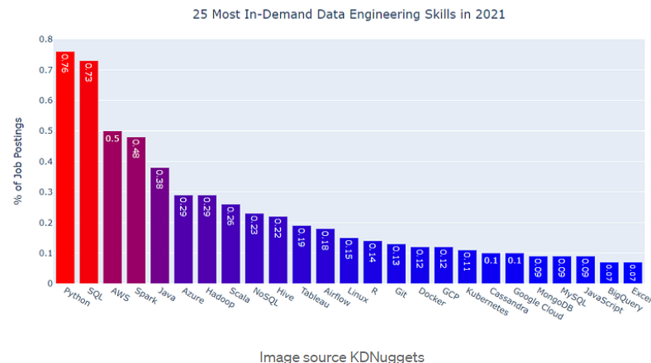
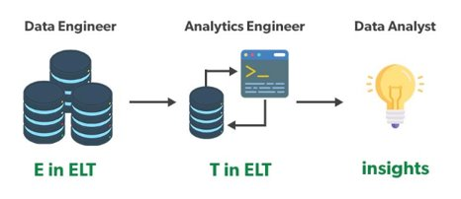
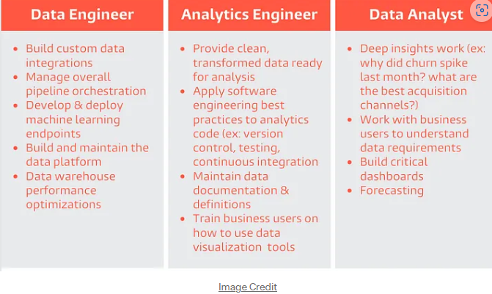

New role born
Notes:
Dbt sử dụng 2 skill quan trọng nhất trong hệ sinh thái Data là SQL và Python

Slide 10
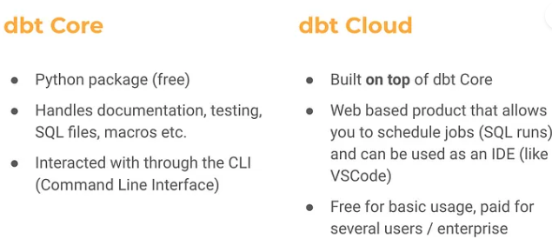
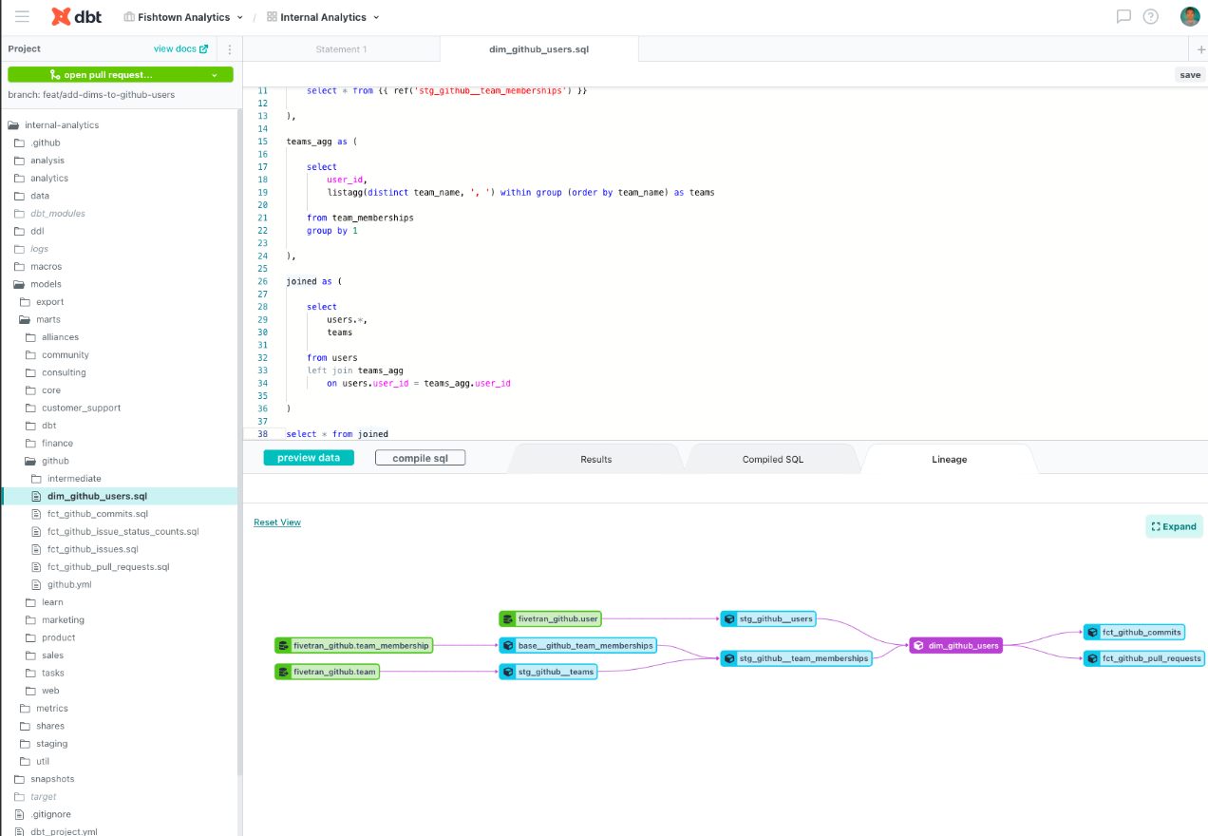
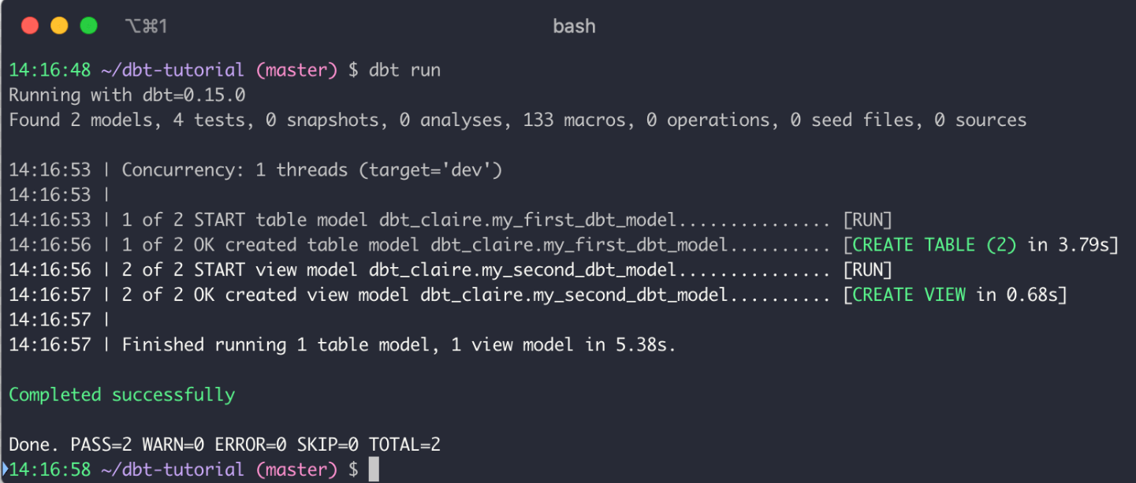
Dbt cloud vs Dbt core (cli)
dbt cloud vs dbt core: a quick comparison - CastorDoc Blog
Evaluating dbt Cloud features vs dbt Core | Datafold

Slide 11
Why Dbt
Open source for using onprem, subscription on Cloud version (of course)
Easy and Simple for non-engineer
Shared data knowledge between engineer and non-engineer teams
Data Lineage (Dag)
Built-in testing for data quality
Cloud with multiple feature (on-prem cli still there)
Compatible for multiple platform
Versioning and Agile method
Dry principle (build reusable and modular code using Jinja)
Notes:
Vấn đề đầu tiên là
What is dbt (data build tool) and What Can It Do for My Data Pipeline? (analytics8.com)

Slide 12
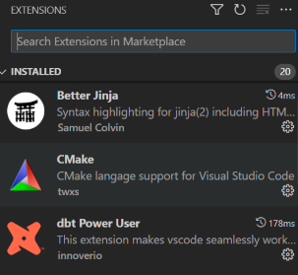
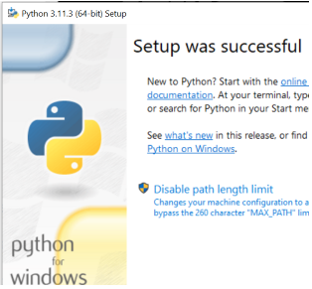
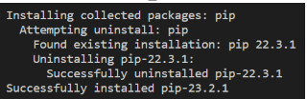
Dbt Installation Check list for Windows
Microsoft Visual C++ : https://visualstudio.microsoft.com/visual-cpp-build-tools/
Download buildtool -> Run file -> Chose Desktop development with C++
VSCode : Visual Studio Code - Code Editing. Redefined
Make sure VSCode have dbt and Cmake extension
Git : Git - Downloads (git-scm.com)
Python : Download Python | Python.org
Update Pip : python.exe -m pip install --upgrade pip
Install Python Virtual Env
Install dbt-core and adaptor (Oracle, Bigquery, DataBrick …)
Project directories : https://git.homecredit.net/country/vn/dataplatforms/pocs/poc_sbv_dbt
Configure connection (profiles.yml)
Notes:
Country / Vietnam / Data Platforms / POCs / POC_SBV_DBT · GitLab (homecredit.net)

Slide 13
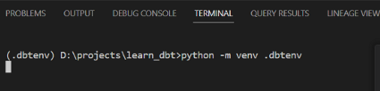
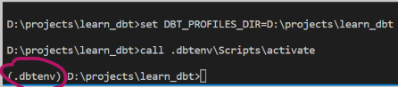
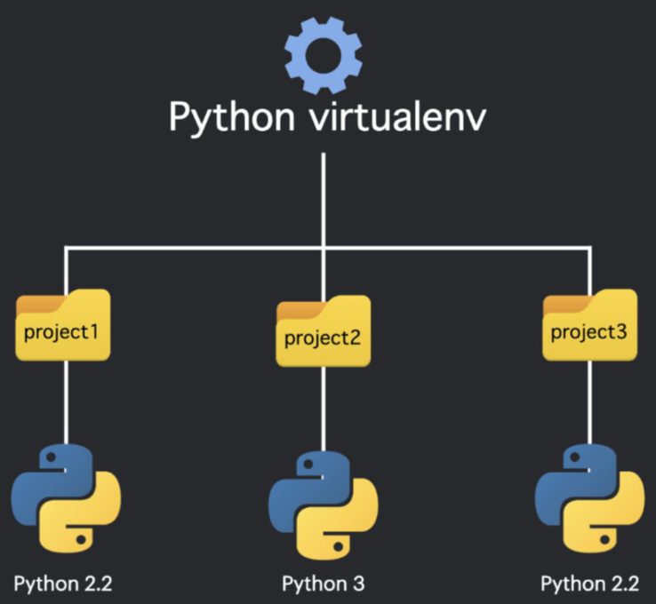
Installation - Python Virtual env
Setup Python Virtual Env into Project Folder : python -m venv .dbtenv

Slide 14
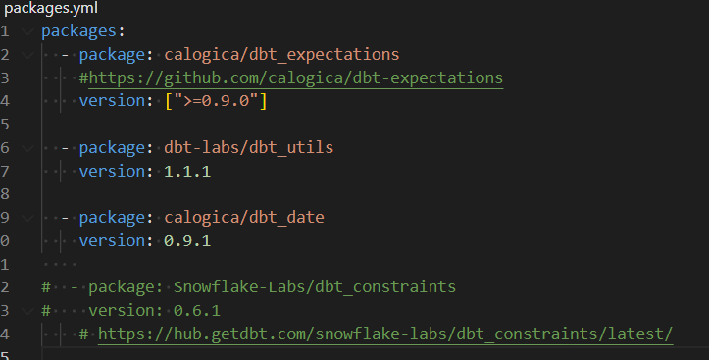
Install dbt
Prepare packages.yml
Install dbt-core
pip install -r dbt-core
Install dbt libraries
dbt clean
dbt deps

Slide 15
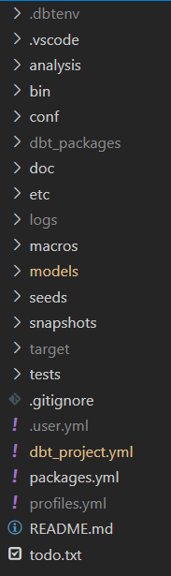
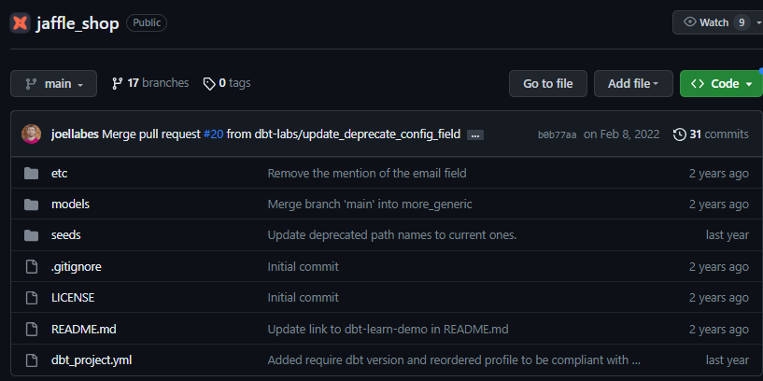
Installation - Create dbt directories structure
Structure init can be clone from dbt repo
https://github.com/dbt-labs/jaffle_shop.git
Notes:
https://github.com/chuongnh1709/dbt_init.git

Slide 16
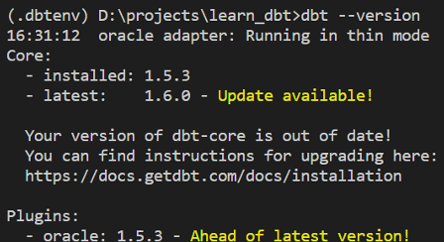
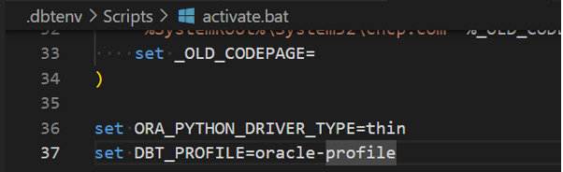
Install dbt for Oracle
Install specific version of dbt-core compatible with oracle
pip install --force-reinstall -v "dbt-core==1.5.3"
Install dbt-oracle
pip install dbt-oracle
Incase conflict with other adaptor -> reinstall dbt-core
pip uninstall dbt-core
pip install --force-reinstall -v "dbt-core==1.5.3"
Configure dbt to use python-oracledb (instead of cx-oracle
Edit : learn_dbt/.dbtenv/Scripts/activate.bat
add : set ORA_PYTHON_DRIVER_TYPE=thin
Notes:
Note : ko install các plugin dbt khác chung với dbt-oracle trong cùng 1 Venv (do conflict version)

Slide 17
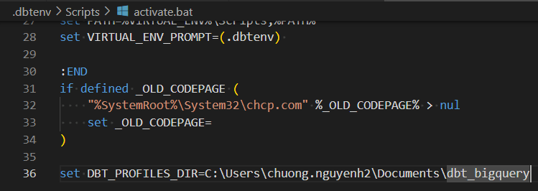
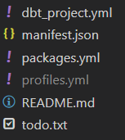
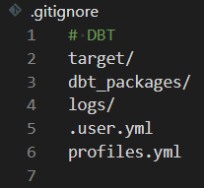
Dbt profile.yml
By default, dbt look in Home for profiles.yml
C:\Users\chuong.nguyenh2\.dbt\profiles.yml
Profile Path can be edit by set environment variables
For security dbt recommend store profiles.yml at local home, outside of project directory
Notes:
Dbt recommend file profile đặt ngoài thư mục Project của Dbt để ko Sync Username , Password lên Git

Slide 18
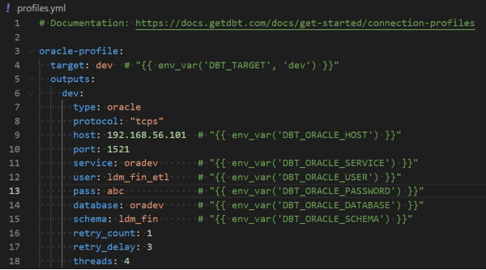
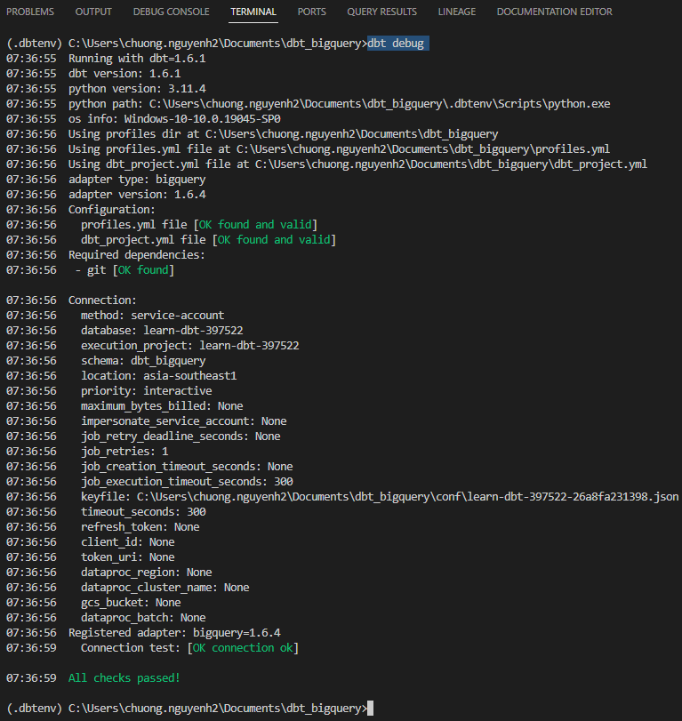
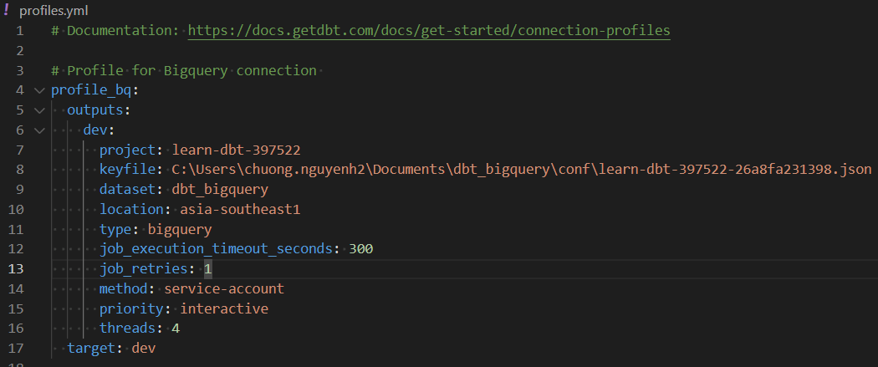
Dbt profile.yml
Configure profile.yml for connection
Check connection : dbt debug

Slide 19
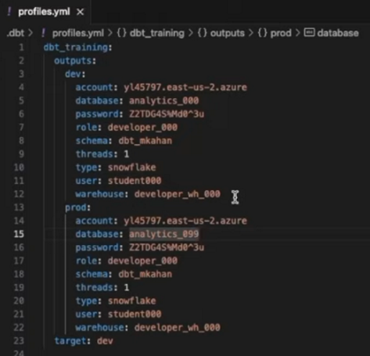
Dbt profile.yml
Multiple environment / target
Target: dev (default target)
dbt build --target prod
dbt compile --target prod

Slide 20
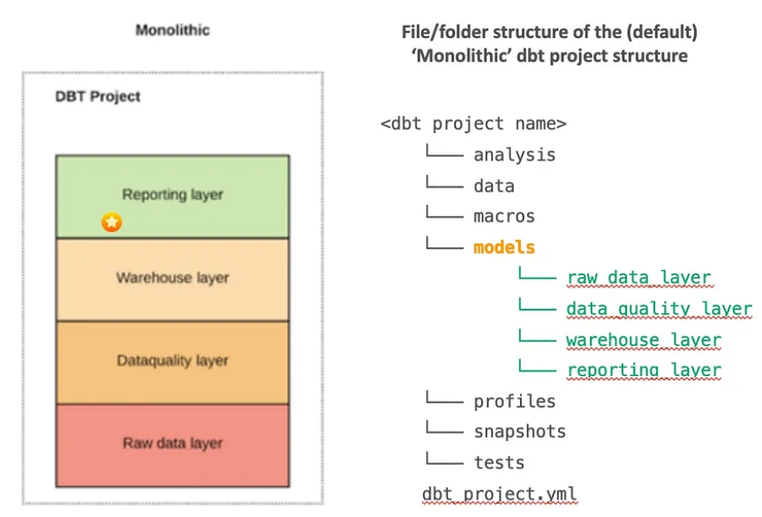
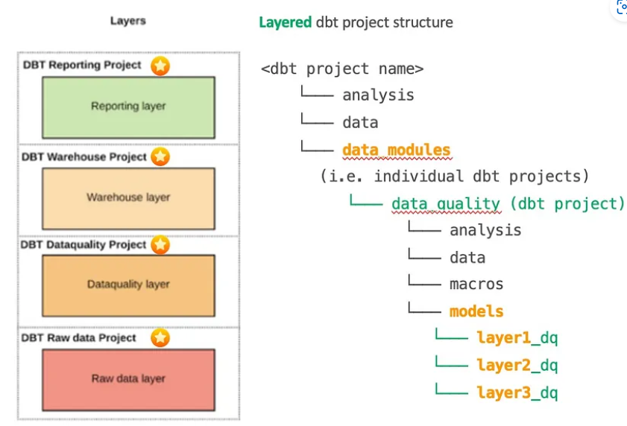
Dbt Structure
Source ; Seed ; Base
Bronze / Private (Owner_int)
Staging
Silver / Protected (Owner_stg)
DWH ; Mart
Gold / Public (Owner_dwh ; LDM_)
Monolithic project vs ‘Layers’ Project Structure (Multiple DBT Projects)
Notes:
Unlike models, which are executed and materialized in the database, analysis files are compiled but not executed. They serve as reusable SQL templates for data exploration and analysis.

Slide 21
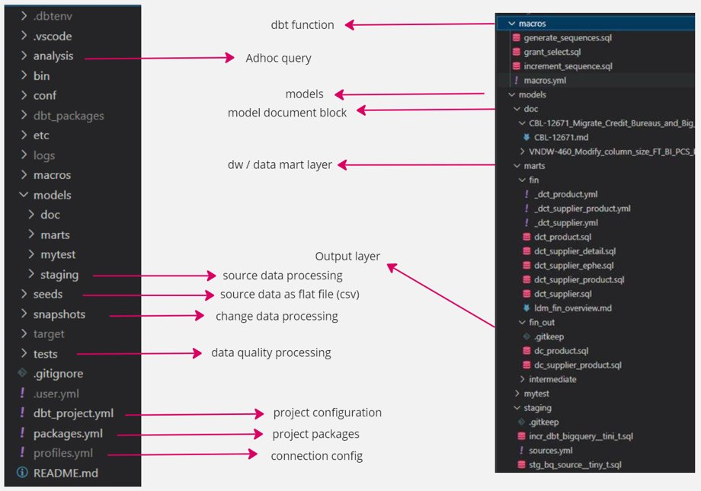
Dbt Structure

Slide 22
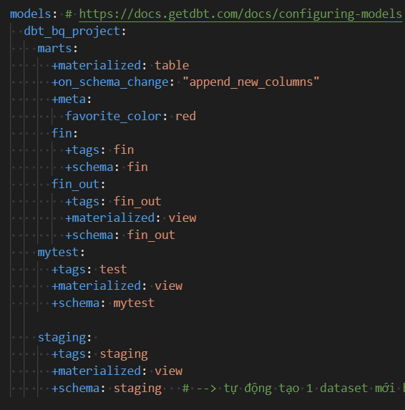
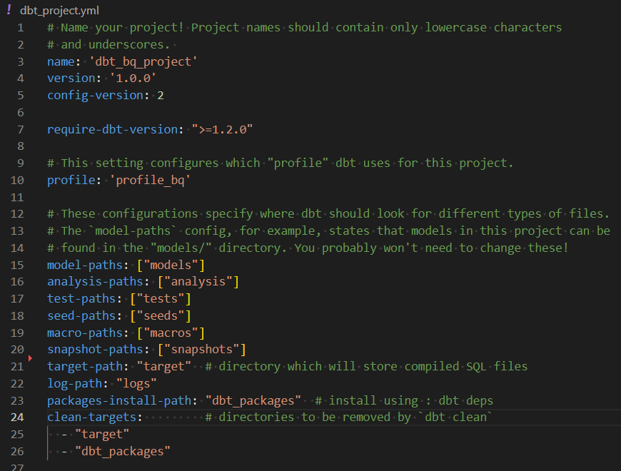
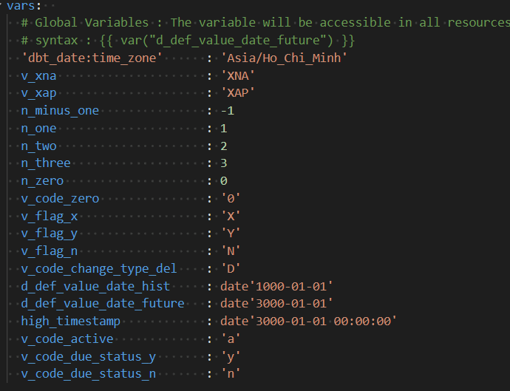
Dbt Project.yml
Notes:
Cấu hình con sẽ đc ưu tiên dùng, ko chỉ định thì lấy cấu hình của cha

Slide 23
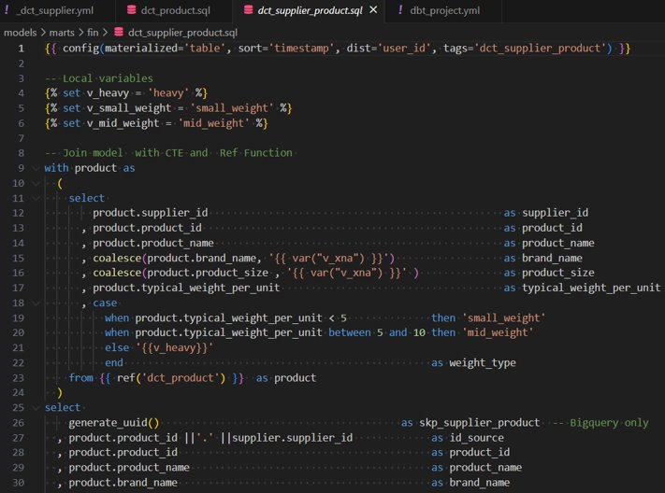
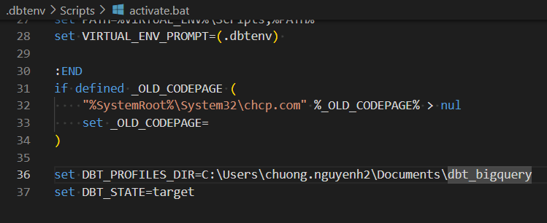
Dbt Variable
Global variables
Local variables
Env variables

Slide 24
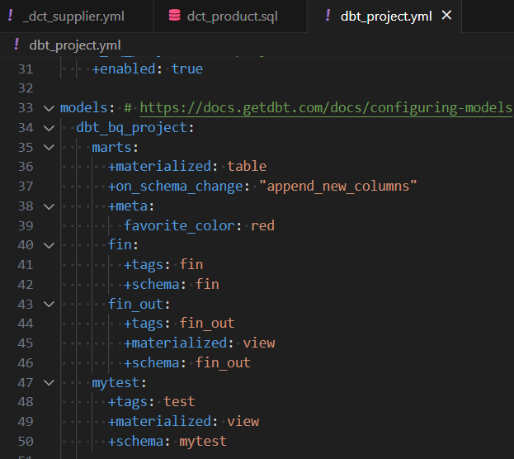
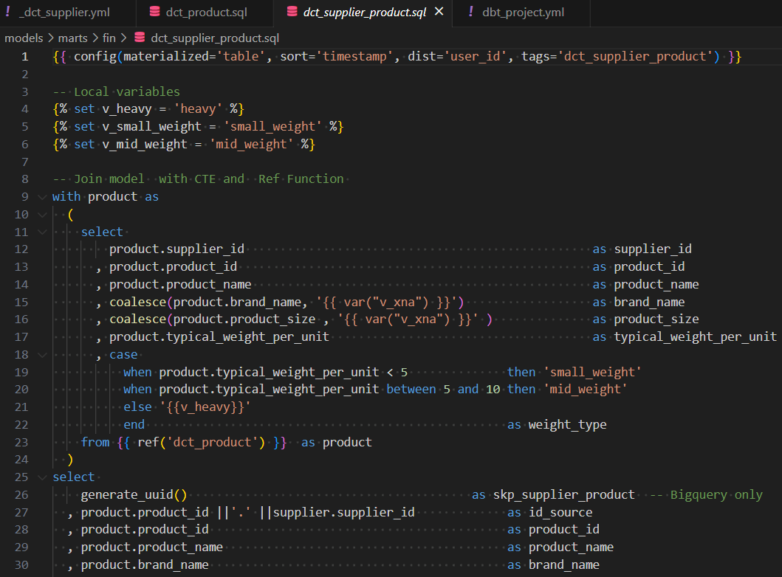
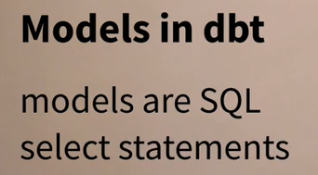
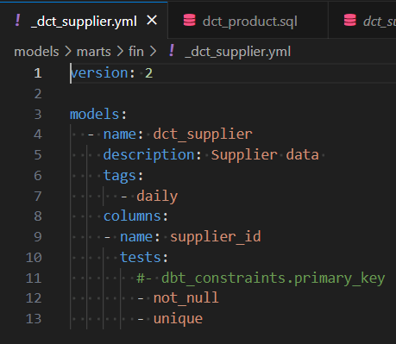
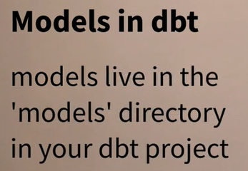
Dbt Model
Model can be SQL or Python
Model configuration can be store in 3 placed
Model names need to be unique (even if in different directories)
Ref : https://docs.getdbt.com/docs/build/sql-models#section-everything-is-a-select
Notes:
dbt Models in SQL: Examples & Best Practices | PopSQL
Model can by SQL or Python
- Python is not supported for non-model resource types like tests and macros in dbt. Python can only be used for writing dbt models.

Slide 25
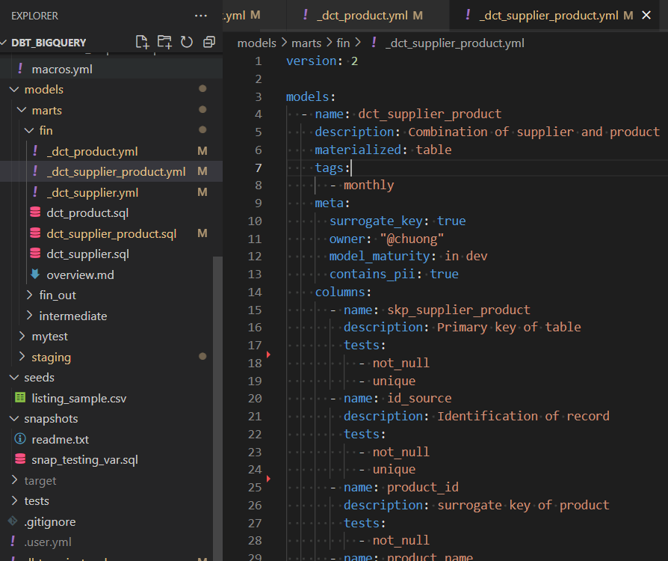

Dbt Model Schema
Description
Configuration
Notes:
Defining a schema source property | dbt Developer Hub (getdbt.com)
Model configurations | dbt Developer Hub (getdbt.com)
Meta : thông tin phụ trợ

Slide 26



Dbt – Seed
Notes:
Dbt sẽ load seed vào 1 model có tên là tên file của seed

Slide 27


Dbt – Source function
Reference to declared tables
Notes:
Source là 1 function tham chiếu tới data nguồn nằm trong staging model
Có 2 tuỳ chọn
- Tạo ra 1 base model có data mapping 1:1
- dùng Source function tham chiếu tới source để tạo ra staging model luôn mà ko cần kéo data từ Source về Base model

Slide 28

Dbt – Source freshness
dbt source freshness : query all source tables
If the tables are stale (based on freshness config) dbt will report a warning or error accordingly
# Snapshot freshness for all Snowplow tables: $ dbt source freshness --select source:snowplow # Snapshot freshness for a particular source table: $ dbt source freshness --select source:snowplow.event
Notes:
freshness | dbt Developer Hub (getdbt.com)

Slide 29



Dbt – Source vs Base layer
Source and Base both the input for next transform Layer which is Staging
Source :
Data is referenced to source database
Base :
Base directory place inside Staging
Base is the model which have 'base_' prefix
Base materialize (view , table) place on DW
Stg_model
Base_model
Notes:
Sources and staging | dbt Developer Hub (getdbt.com)
Staging: Preparing our atomic building blocks | dbt Developer Hub (getdbt.com)
-- Source và Base đều là data từ nguồn
Source và Base đều là nguồn cho layer tiếp theo là Staging
Source : data được tham chiếu từ dbt tới nguồn , thông qua cấu hình , ko kéo về DW
Base : data được replicate 1:1 từ source vào DW
Thư mục Base là con của thư mục staging
Base : là 1 model có tiền tố base_ -> có materialize nằm trên Data Warehouse

Slide 30




Dbt – Staging Layer
Name : stg_stripe__payments (plural, stg_source__names)
Staging used for :
Staging NOT used For
Ref : https://docs.getdbt.com/guides/best-practices/how-we-structure/2-staging
Notes:
Staging: Preparing our atomic building blocks | dbt Developer Hub (getdbt.com)

Slide 31



Dbt – Intermediate Layer
Name (stt_) : int_[entity]s__[verb]s.sql , ex: int_core__orders_summed , int_shopify__orders_summed
Used for
Temporary model
Isolating complex operation
Do and dont
Materialize ephemeral or view
Expose to user
Ref : Intermediate: Purpose-built transformation steps | dbt Developer Hub (getdbt.com)
Notes:
Intermediate: Purpose-built transformation steps | dbt Developer Hub (getdbt.com)

Slide 32



Dbt – Ref function
Notes:
Function tham chiếu
Thứ tự chạy của các model tham chiếu được tự động bảo đảm.

Slide 33


Dbt - Model Dependencies
Dbt will automatically build dependants models first

Slide 34
Dbt run
$ dbt run --thread 2 # runs all models in 2 threads
$ dbt run --select my_dbt_model # runs a specific model
$ dbt run --select my_first_model my_second_model # multiple models
$ dbt run --select my_dbt_model+ # current model with all children
$ dbt run --select +my_dbt_model # current model with all parent
$ dbt run --select +my_dbt_model+ # current model with all parent and children
$ dbt run --models @modelname # will run modelname, all parents, all children, and all parents of all children
$ dbt run --exclude modelname # will run all models except modelname
$ dbt run --select tag:nightly # run models with the "nightly" tag
$ dbt run --models +tag:tagname # will run tagged models and all parents.
$ dbt run --models tag:tagname+ # will run tagged models and all children.
$ dbt run --select path/to/models # run models contained in path/to/models
$ dbt run --select finance.base.* # runs all models in a specific directory
$ dbt run --select path/to/my_model.sql # run a specific model by its path
$ dbt run --select path:marts/finance, tag:nightly, config.materialized:table # complex selectors

Slide 35


Dbt build vs run
Validates tests and then runs the downstream models, while dbt run runs prior to testing
dbt build is the preferred way to run models in production environments
Ensures that your data transformations are tested before they are run, which can help prevent data quality issues
$ dbt build --model dct_product
$ dbt run --model dct_product
Notes:
dbt build Command: Usage & Examples - PopSQL

Slide 36

Dbt run - Failling Fast
dbt run --fail-fast --thread 4
dbt exit immediately if a single resource fails to build.
Notes:
Ví dụ những model nằm trong cùng 1 CBL/nhóm

Slide 37
Dbt run - Full-refresh
dbt run --full-refresh --select my_model+
Drop and recreate table
Main disadvantages: - High processing cost - High processing time
When to use: - When you don’t need to worry about cost and time (small tables or tables with simple transformations) - When data is more static than dynamic - When historical data changes frequently

Slide 38




Model Materialization
Table
View
Incremental (table enhance)
Snapshot (special enhance)
Ephemeral
Materialized view
Ref :
Materializations | dbt Developer Hub (getdbt.com)
Available materializations | dbt Developer Hub (getdbt.com)​
Best practices for materializations | dbt Developer Hub (getdbt.com)
Notes:
Materialization : cách thể hiện của Model dưới database

Slide 39
Dbt - Ephemeral Model
Not directly built into the database. Instead, dbt will interpolate the code from this model into dependent models as a CTE. (like STT_ table )
Pros:
Reusable logic
Help keep data warehouse clean by reducing temporary view or table
Cons:
Cannot select directly from this model.
Overuse of ephemeral materialization can also make queries harder to debug.
Advice: Use the ephemeral materialization for:
very light-weight transformations that are early on in your DAG
are only used in one or two downstream models
do not need to be queried directly
Notes:
Materializations | dbt Developer Hub (getdbt.com)

Slide 40



Dbt - Ephemeral Model
Config model
Dct_supplier_detail refer to Ephemeral model
No Ephemeral model created on dataset
Notes:
Materializations | dbt Developer Hub (getdbt.com)
Oracle not support ephemeral model

Slide 41


Dbt Incremental model
To use incremental models, you also need to tell dbt - How to filter the rows on an incremental run - The unique key of the model (if any)
When to Use - When source data is huge and models take up too much time to run - When historical data doesn’t change - When table updates are needed frequently
Ref : Incremental models | dbt Developer Hub (getdbt.com) Incremental models in-depth | dbt Developer Hub (getdbt.com)
Notes:
Now you might have noticed that MVs sound a lot like incremental models, and you are not wrong! It can be worthwhile to think of materialized views as a successor of sorts to incremental models
you will no longer have to manually craft specific incremental strategies, detailing how dbt should update the underlying table. Awesome, right?

Slide 42

Dbt Incremental model
Defining a unique key (optional)
Enables updating existing rows
Not specifying a unique_key will result in append-only behavior
is_incremental() macro will return True if all of the following conditions are met:
the destination table already exists in the database
dbt is not running in full-refresh mode
the running model is configured with materialized='incremental'
this (computer programming) - Wikipedia
Notes:
'this' is the database representation of the current model. It is useful when:
Defining a where statement within incremental models
Using pre or post hooks

Slide 43

Incremental model – Merge Strategy
How do incremental models work behind the scenes?
Where supported, a merge statement is used to insert new records and update existing records.
On warehouses that do not support merge statements, a merge is implemented by first using a delete statement to delete records in the target table that are to be updated, and then an insert statement.
If the table didn’t exist it would run a create statement.
Notes:
Incremental models | dbt Developer Hub (getdbt.com)
On adapters which support the merge strategy (including Snowflake, BigQuery, Apache Spark, and Databricks), you may optionally pass a list of column names to a merge_update_columns config.
In that case, dbt will update only the columns specified by the config, and keep the previous values of other columns.
{{ config( materialized = 'incremental', unique_key = 'id', merge_update_columns = ['email', 'ip_address'], ... ) }} select ...

Slide 44


Incremental Model – Schema Change
$ dbt run --full-refresh --select my_incremental_model+
On_schema_change

Slide 45
Incremental Model – Late Arriving Facts
Data come late
Entire load come late
Some records come late
Late can be hours late or days late
Solution
Lookback window / cutoff point : every last 2 hours ; t-1 ; t-2 …
The longer windows the less efficient model but slower the diff
Full-refresh : $ dbt run --full-refresh --select my_incremental_model+

Slide 46



Slowly Change Dimension
SCD Type 0 : Fixed dimension - Dimension is never update
SCD Type 1 : No History - Dimension is overwritten
SCD Type 2 : Row Versioning - Maintain old records
SCD Type 3 : Previous value column - Maintain old attribute in same row
SCD Type 4 : History table - Current records and history record in different table
SCD Type 6 : = 1+2+3 - Hybrid SCD
SCD Type 5 & 7 - Seldom used
Type 2
Type 4
Type 6
Type 3
Notes:
Method to store CDC in DW

Slide 47


Dbt - Snapshot model
Snapshot : "look back in time" at previous data states
Snapshots implement type-2 Slowly Changing Dimensions over source tables
On the first run : initial snapshot table . All records will have a dbt_valid_to = null
On subsequent runs :check which records have changed
dbt_valid_to column will be updated
dbt_valid_to = null
Run the dbt snapshot command
Notes:
Add snapshots to your DAG | dbt Developer Hub (getdbt.com)
dbt snapshot Command: Strategies & Examples - PopSQL
dbt Snapshots: The Definitive Guide | Hightouch

Slide 48


Dbt - Snapshot meta-fields
Auto generated by dbt
Dbt_scd_id ~ skp_proc_updated
Notes:
Technical Columns

Slide 49


Dbt - Snapshot Strategy
Timestamp strategy (recommended)
Use updated_at field (ex: dtime_updated )
Updated_at column must have timestamp data type
Check strategy
tables which do not have a reliable updated_at column
works by comparing a list of columns between their current and historical values

Slide 50

Dbt - Snapshot Strategy
Hard deletes (opt-in)
Not enable by default
Rows that are deleted from the source are not invalidated by default
dbt can track rows that no longer exist
done by left joining the snapshot table with the source table

Slide 51
Recap
Next
Dbt = Data Build Tool . T for Transform
Installation : dbt-core + adaptor (dbt-oracle)
Configure :
profile.yml -> dbt_projects.yml -> _schema.yml -> specific model
Structure / Layer : (bronze – silver - gold)
Base/source -> staging -> [intermediate] -> marts (dw, data mart)
Model : sql , python
Meterialize : View, Table , Incremental , Snapshot
Source function : reference to declared tables or model
Ref function for model dependecies
dbt build vs dbt run
Test vs Constraint
dbt-util ; dbt-expectation
Doc block
Description
md docs
docs generate
dbt debug
Best practise
Dry principal
Jinjas template
Macros

Slide 52


Check-up

Slide 53

Check-up

Slide 54



Dbt – Tests
Dbt offers four generic tests : unique, not_null, accepted_values, and relationships.
Singular test / custom test place in test folder
Test queries are written to return a set of failing records
Notes:
Add tests to your DAG | dbt Developer Hub (getdbt.com)
Writing custom generic tests | dbt Developer Hub (getdbt.com)
Model contracts | dbt Developer Hub (getdbt.com)

Slide 55



Dbt – Tests
Singular test / custom test place in test folder
Tests whether there are any values in that dimension that exceed 2 characters.
Notes:
Add tests to your DAG | dbt Developer Hub (getdbt.com)
Writing custom generic tests | dbt Developer Hub (getdbt.com)
Model contracts | dbt Developer Hub (getdbt.com)

Slide 56


Dbt – Tests
Singular test / custom test place in test folder
{{ config(severity = 'warn') }}

Slide 57

Dbt – Data Contract
The contract is the set of guarantees about the shape of the returned dataset. That includes, for every column in a model (forcing)
If model does not match its contract , it will fail to build
Notes:
Model contracts | dbt Developer Hub (getdbt.com)
Model contracts · dbt-labs/dbt-core · Discussion #6726 (github.com)

Slide 58




dbt-expectations
Dbt-expectations is a dbt testing package inspired by the Python testing library
Tests in dbt-expectations are written in YAML templates using a combination of SQL, Jinja and dbt macros
Add into packages.yml --> dbt deps

Slide 59




dbt-expectations
Stale data test (upstream data pipeline issues)
expect_row_values_to_have_recent_data. This one takes a timestamp column as input and allows you to set a time threshold to check for
expect_column_to_exist
expect_column_values_to_not_be_null
Incorrect data type test
For this, dbt-expectations has two tests: expect_column_values_to_be_of_type and expect_column_values_to_be_in_type_list.
Using dbt_utils

Slide 60







dbt-utils
dbt-utils is a collection of pre-written macros that helps you with things like pivoting, writing generic tests, generating a data spine, and a lot more
Install
Test
Macro
Notes:
dbt-labs/dbt-utils: Utility functions for dbt projects. (github.com)

Slide 61


dbt-utils
Dbt-utils in Model : convert resultset into json obj
Jinja helper : pretty-time
Instrospective Macros
Run a query and return resuls of the querys as objects / dict
Notes:
macros/jinja_helpers/slugify.sql
{% macro slugify(string) %}
{#- Lower case the string -#}
{% set string = string | lower %}
{#- Replace spaces and dashes with underscores -#}
{% set string = modules.re.sub('[ -]+', '_', string) %}
{#- Only take letters, numbers, and underscores -#}
{% set string = modules.re.sub('[^a-z0-9_]+', '', string) %}
{#- Prepends "_" if string begins with a number -#}
{% set string = modules.re.sub('^[0-9]', '_' + string[0], string) %}
{{ return(string) }}
{% endmacro %}

Slide 62
dbt-utils.deduplication
SELECT date, name, sales, status FROM ( {{ dbt_utils.deduplicate(source('data', 'sales'), "date, name", "status") }} )
The Stratergy :
with counting_rows AS ( SELECT date, name, sales, status, ROW_NUMBER() OVER(PARTITION BY date, name ORDER BY status) AS rn FROM {{ source('data', 'sales') }} )
SELECT * EXCEPT(rn) FROM counting_rows WHERE rn = 1

Slide 63



Dbt – Doc Blocks
Edit markdown for model
In model schema, reference to doc
Notes:
About doc function | dbt Developer Hub (getdbt.com)
About documentation | dbt Developer Hub (getdbt.com)

Slide 64




Dbt – Doc Generate
dbt docs generate
dbt docs serve

Slide 65


Dbt – Doc Generate
dbt docs generate
dbt docs serve

Slide 66
Dbt – Debuging
General process of debugging
Read the console message
Isolate the problem — for example, by running one model a time, or by undoing the code that broke things
Get comfortable with compiled files and the logs
target/compiled directory contains select statements that you can run in any query editor
The target/run directory contains the SQL dbt executes to build your models
logs/dbt.log file contains all the queries that dbt runs, and additional logging. Recent errors will be at the bottom of the file
If you are really stuck, try asking for help (dbt Community Forum (getdbt.com)
Notes:
Model contracts | dbt Developer Hub (getdbt.com)
Model contracts · dbt-labs/dbt-core · Discussion #6726 (github.com)

Slide 67
Dbt – Best Practise
Use ref Function
Add tests to your models
Use prefixes in table names (stg_, fct_ and dim_) ex : stg_bsl__contract (1 _ vs 2__ )
prefix_DataSource__TableName
Choose your materializations wisely
Views are faster to build, but slower to query compared to tables.
Incremental models provide the same query performance as tables, are faster to build compared to the table
Dry principal (Jinja template)
Run necessary model only : dbt run --models xxx+ yyy+ vs dbt run
Build the Model twice not 1
Remember schema change strategy and limitations
Best practices | dbt Developer Hub (getdbt.com)
Notes:
Hệ thống đặt tên của dbt : prefix_nguồn__tênBảng
Best practices | dbt Developer Hub (getdbt.com)

Slide 68

Dbt – Best Practise
Break complex models up into smaller pieces
Notes:
Intermediate models, a flexible tool for modeling DRY dbt data pipelines | by Jeremie Pineau | ${around_the_block} (montrealanalytics.com)

Slide 69

Dbt – Make your code Dry-er
Making your code DRY-er by centralizing pieces of logic needed in multiple downstream models
Notes:
Intermediate models, a flexible tool for modeling DRY dbt data pipelines | by Jeremie Pineau | ${around_the_block} (montrealanalytics.com)

Slide 70





Dbt Best Practise - Structure pitfalls - What not to do
Reference : https://discourse.getdbt.com/t/your-dbt-project-checklist/1377/2

Slide 71
Dry - Jinjas template
Jinjas : Templating language for Python
Ref, source, set, config function …
Bring program language into sql
Ref :
dbt Jinja functions | dbt Developer Hub (getdbt.com)
Jinja2 Tutorial - A Crash Course for Beginners (ultraconfig.com.au)

Slide 72



Dry - Jinjas template
Notes:
Jinja template exists everywhere in dbt

Slide 73



Dry - Jinjas template
SQL without Jinja
Use a for loop in models for repeated SQL
Set variables at the top of a model
Ref : Using Jinja | dbt Developer Hub (getdbt.com)
Notes:
Using Jinja | dbt Developer Hub (getdbt.com)
Template Designer Documentation — Jinja Documentation (3.1.x) (palletsprojects.com)
jinja2 - Ansible jinja - If loop last without newline - Stack Overflow

Slide 74



Dry - Macro
Macros in Jinja are pieces of code that can be reused multiple times – they are analogous to "functions" in other programming languages
Notes:
Using Jinja | dbt Developer Hub (getdbt.com)

Slide 75



Dry - Macro
Use a macro to return payment methods
Use a macro to return payment methods from query
Notes:
Using Jinja | dbt Developer Hub (getdbt.com)
About run_query macro | dbt Developer Hub (getdbt.com)
The run_query macro provides a convenient way to run queries and fetch their results

Slide 76


Dry - Macro
Write modular macros​
Use a macro from package
dbt-labs/dbt-utils: Utility functions for dbt projects. (github.com)
Notes:
Using Jinja | dbt Developer Hub (getdbt.com)

Slide 77




Refactoring legacy sql to dbt
Insert
Dbt model
Notes:
Inserts | dbt Developer Hub (getdbt.com)
Refactoring legacy SQL to dbt | dbt Developer Hub (getdbt.com)

Slide 78



Refactoring legacy sql to dbt
Update
Dbt model
Notes:
Updates | dbt Developer Hub (getdbt.com)

Slide 79
Refactoring legacy sql to dbt
Update
create table foobar as select * from blah....;
update foobar set column_name = boo where other_column like '%something%';
update foobar set column_name = boo-else where other_column like '%something-else%';
--> convert to Case..when select case when other_column like '%something%' then 'boo' when other_column like '%something-else%' then 'boo-else' else 'no boo for you' end as column_name from foobar
Apply jinja
categorized_foobar.sql
{% set mappings = {'something': 'boo', 'something-else': 'boo-else'} %}
with source as ( select * from {{ ref(‘stg_foobar’) }} ), final as ( select case {% for old, new in mappings %} when other_column like ‘{{old}}’ then ‘{{new}}’ {% endfor %} end as column_name from source ) select * from final

Slide 80

Refactoring legacy sql to dbt
Delete
Dbt model
Notes:
Deletes | dbt Developer Hub (getdbt.com)

Slide 81



Refactoring legacy sql to dbt
Merge
Dbt model
Notes:
Merges | dbt Developer Hub (getdbt.com)

Slide 82

Refactoring legacy sql to dbt
Refactoring legacy SQL to dbt | dbt Developer Hub (getdbt.com)

Slide 83


Check-up

Slide 84


Check-up

Slide 85
Document
Repo : github.com/dbt-labs/dbt-core
Doc : dbt Developer Hub (getdbt.com)
dbt Fundamentals - Learn Analytics Engineering with dbt | dbt Learn (getdbt.com)
Next
Pre_hook / post_hook (truncate / analyze)
Unit test
Dbt DAG (data lineage)
Model access
Parallel processing
Integrated with airflow
Dbt_artifacts
Migrate legacy code to dbt model
Notes:
Refactoring legacy SQL to dbt | dbt Developer Hub (getdbt.com)
How I Migrate Legacy Code to dbt - by Madison Mae (substack.com)
Migrating from DDL, DML, and stored procedures | dbt Developer Hub (getdbt.com)
Migrating from Stored Procedures to dbt | dbt Developer Blog (getdbt.com)
dbt Semantic Layer | dbt Developer Hub (getdbt.com)

Slide 86

DAG - Direct Acyclic Graph

Slide 87
Dct_contract analyze

